Slide 1
Current Progress
Ella Vahle, Julian Karch, Parinay Singh, Sanket More, Mansoor Soomro
18.01.2023

Slide 2
Agenda
Research Questions
Class Diagram
Sketches
Mosque–Cathedral of Córdoba
Hagia Sophia
Review and Next Steps

Slide 3
Research Question(s)
What are the potential benefits and drawbacks of digitizing sacred spaces through virtual reality?

Slide 4
Research Question(s)
How does the VR environment influence the way people interact with each other?
Can mostly be collected automatically
Direct user feedback needed for subjective aspects
Data from reality needed

Slide 5
Research Question(s)
How does virtual reality technology change the way that people engage with and understand sacred spaces/objects and their history?
Can be collected automatically if objects are available
Direct user feedback needed for subjective aspects
Data from reality needed
Incorporating the corresponding objects

Slide 6
Research Question(s)
How can virtual reality be used to enhance the experience of visiting sacred spaces for those who are unable to physically visit them due to distance or accessibility issues?
Mostly subjective perception
Data from reality needed
Affected people needed

Slide 7
Research Question(s)
How does a VR learning experience differ from the conventional methods when it comes to religious preaching for children?
Mostly subjective perception
Some data can be collected automatically
Data from reality needed
How to define effectiveness and learning effect

Slide 8
Research Question(s)
What are the ethical considerations of using virtual reality in sacred spaces, and how can these be addressed?
Direct user feedback needed
Subjective data

Slide 9
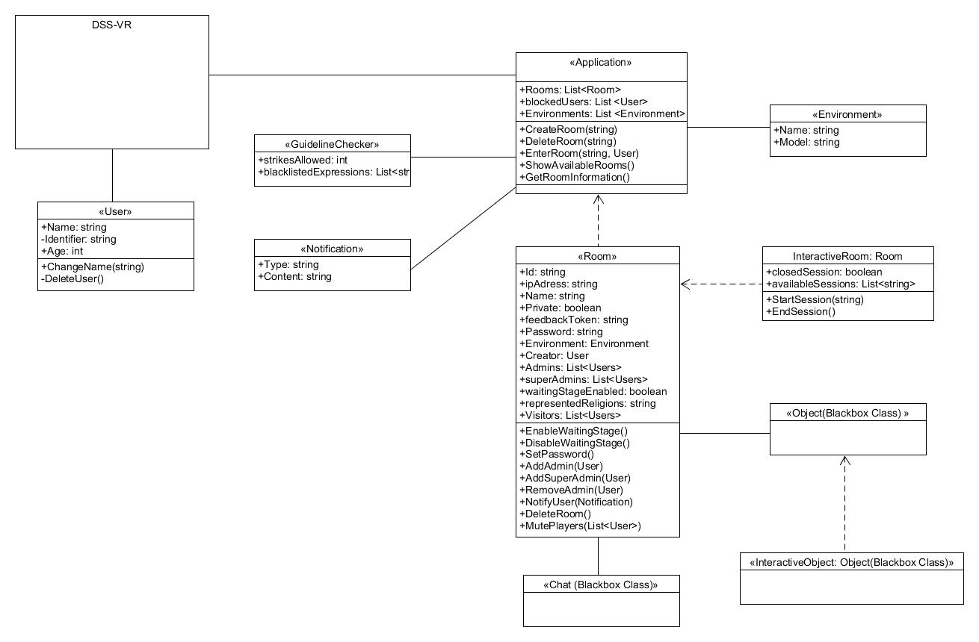
Class Diagram

Slide 10
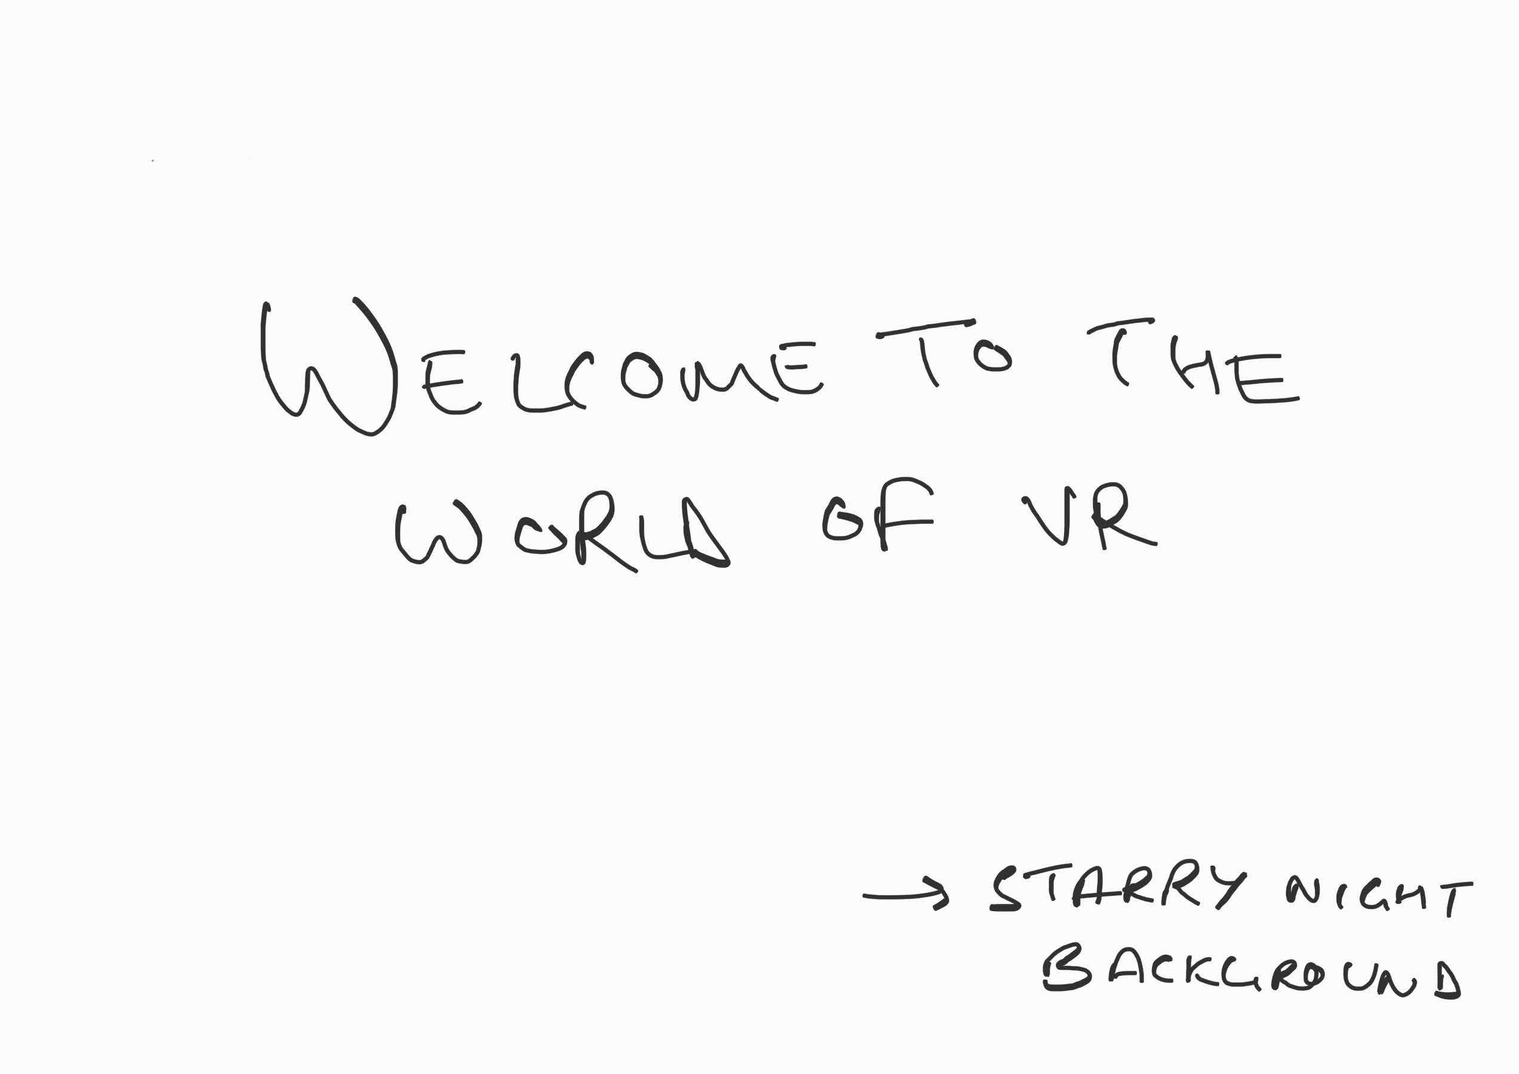
Sketches

Slide 11
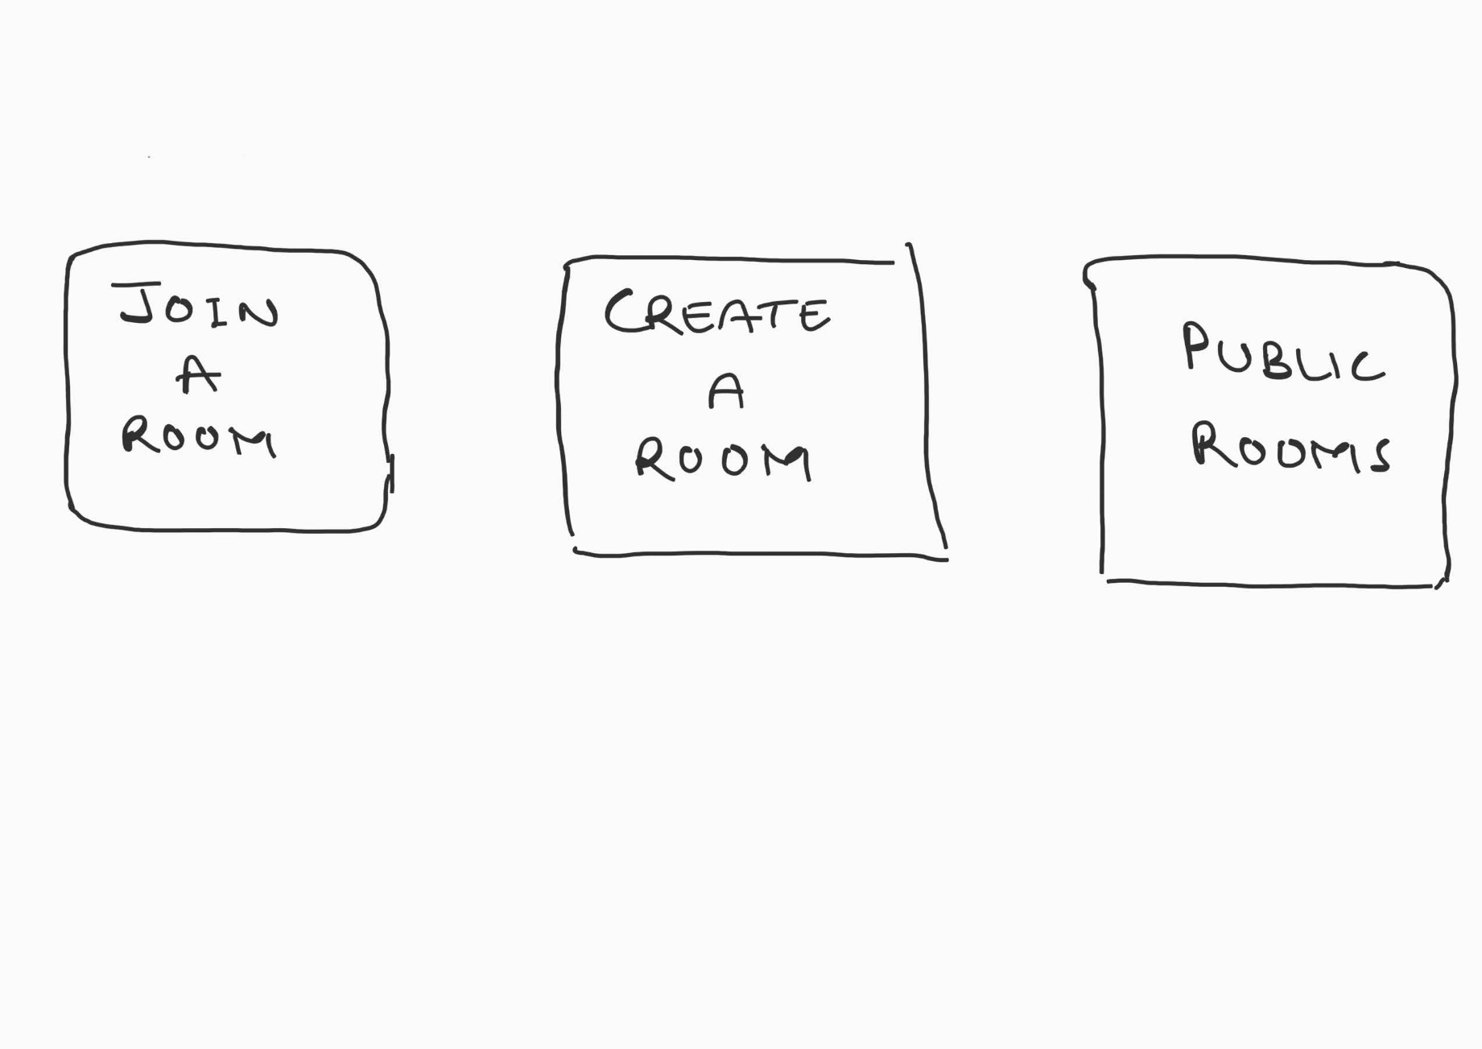
Sketches

Slide 12
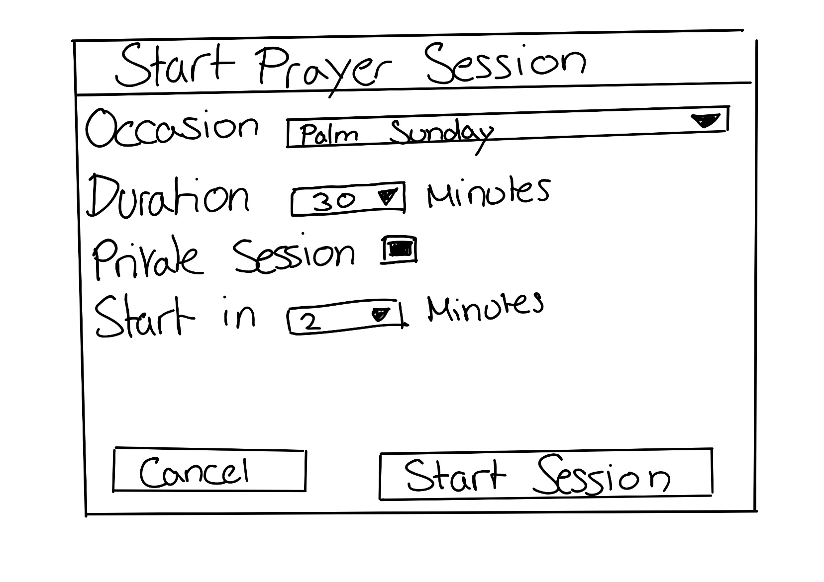
Sketches

Slide 13
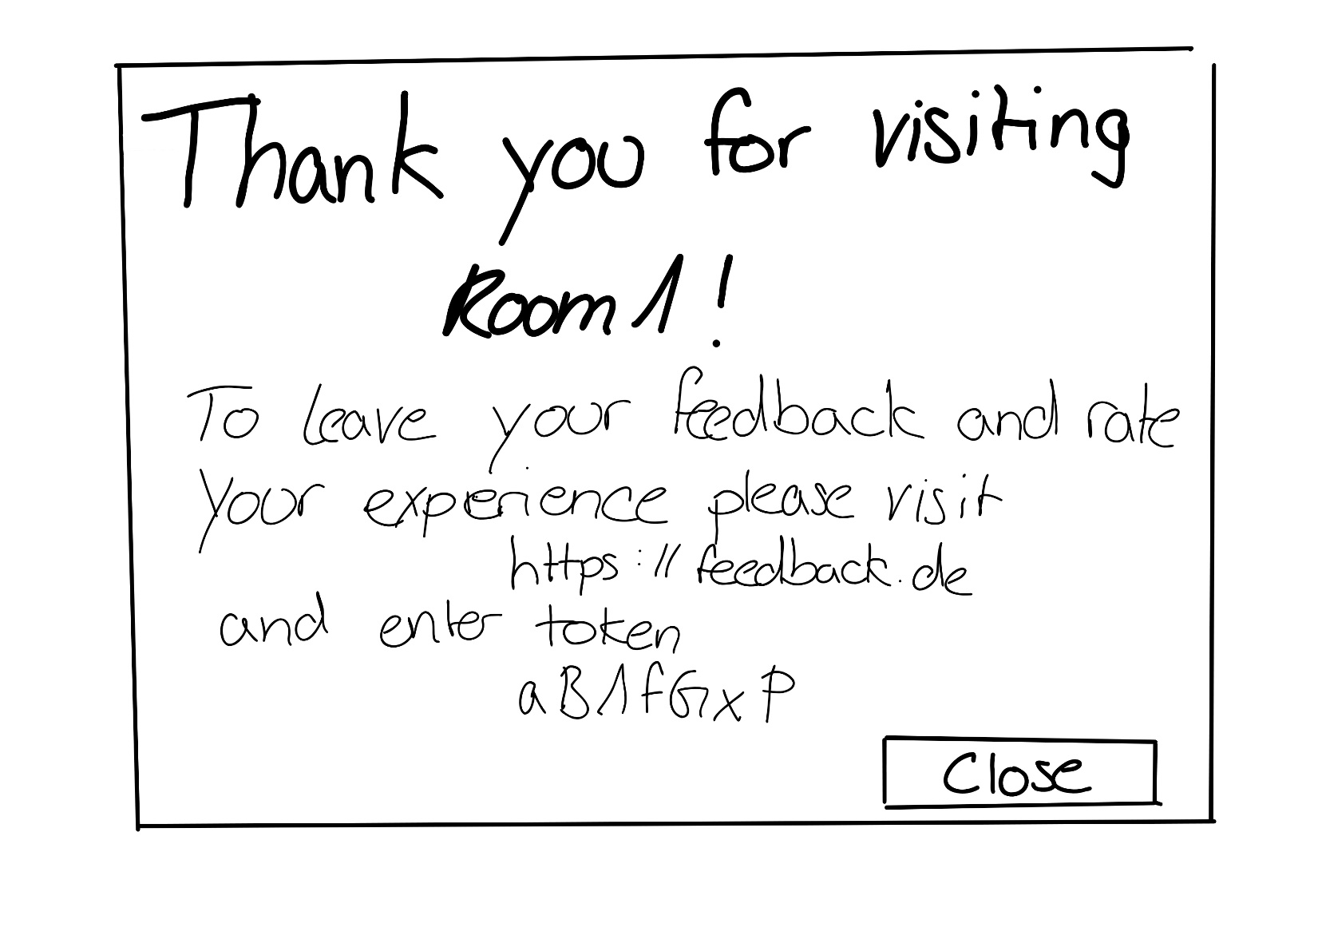
Sketches

Slide 14
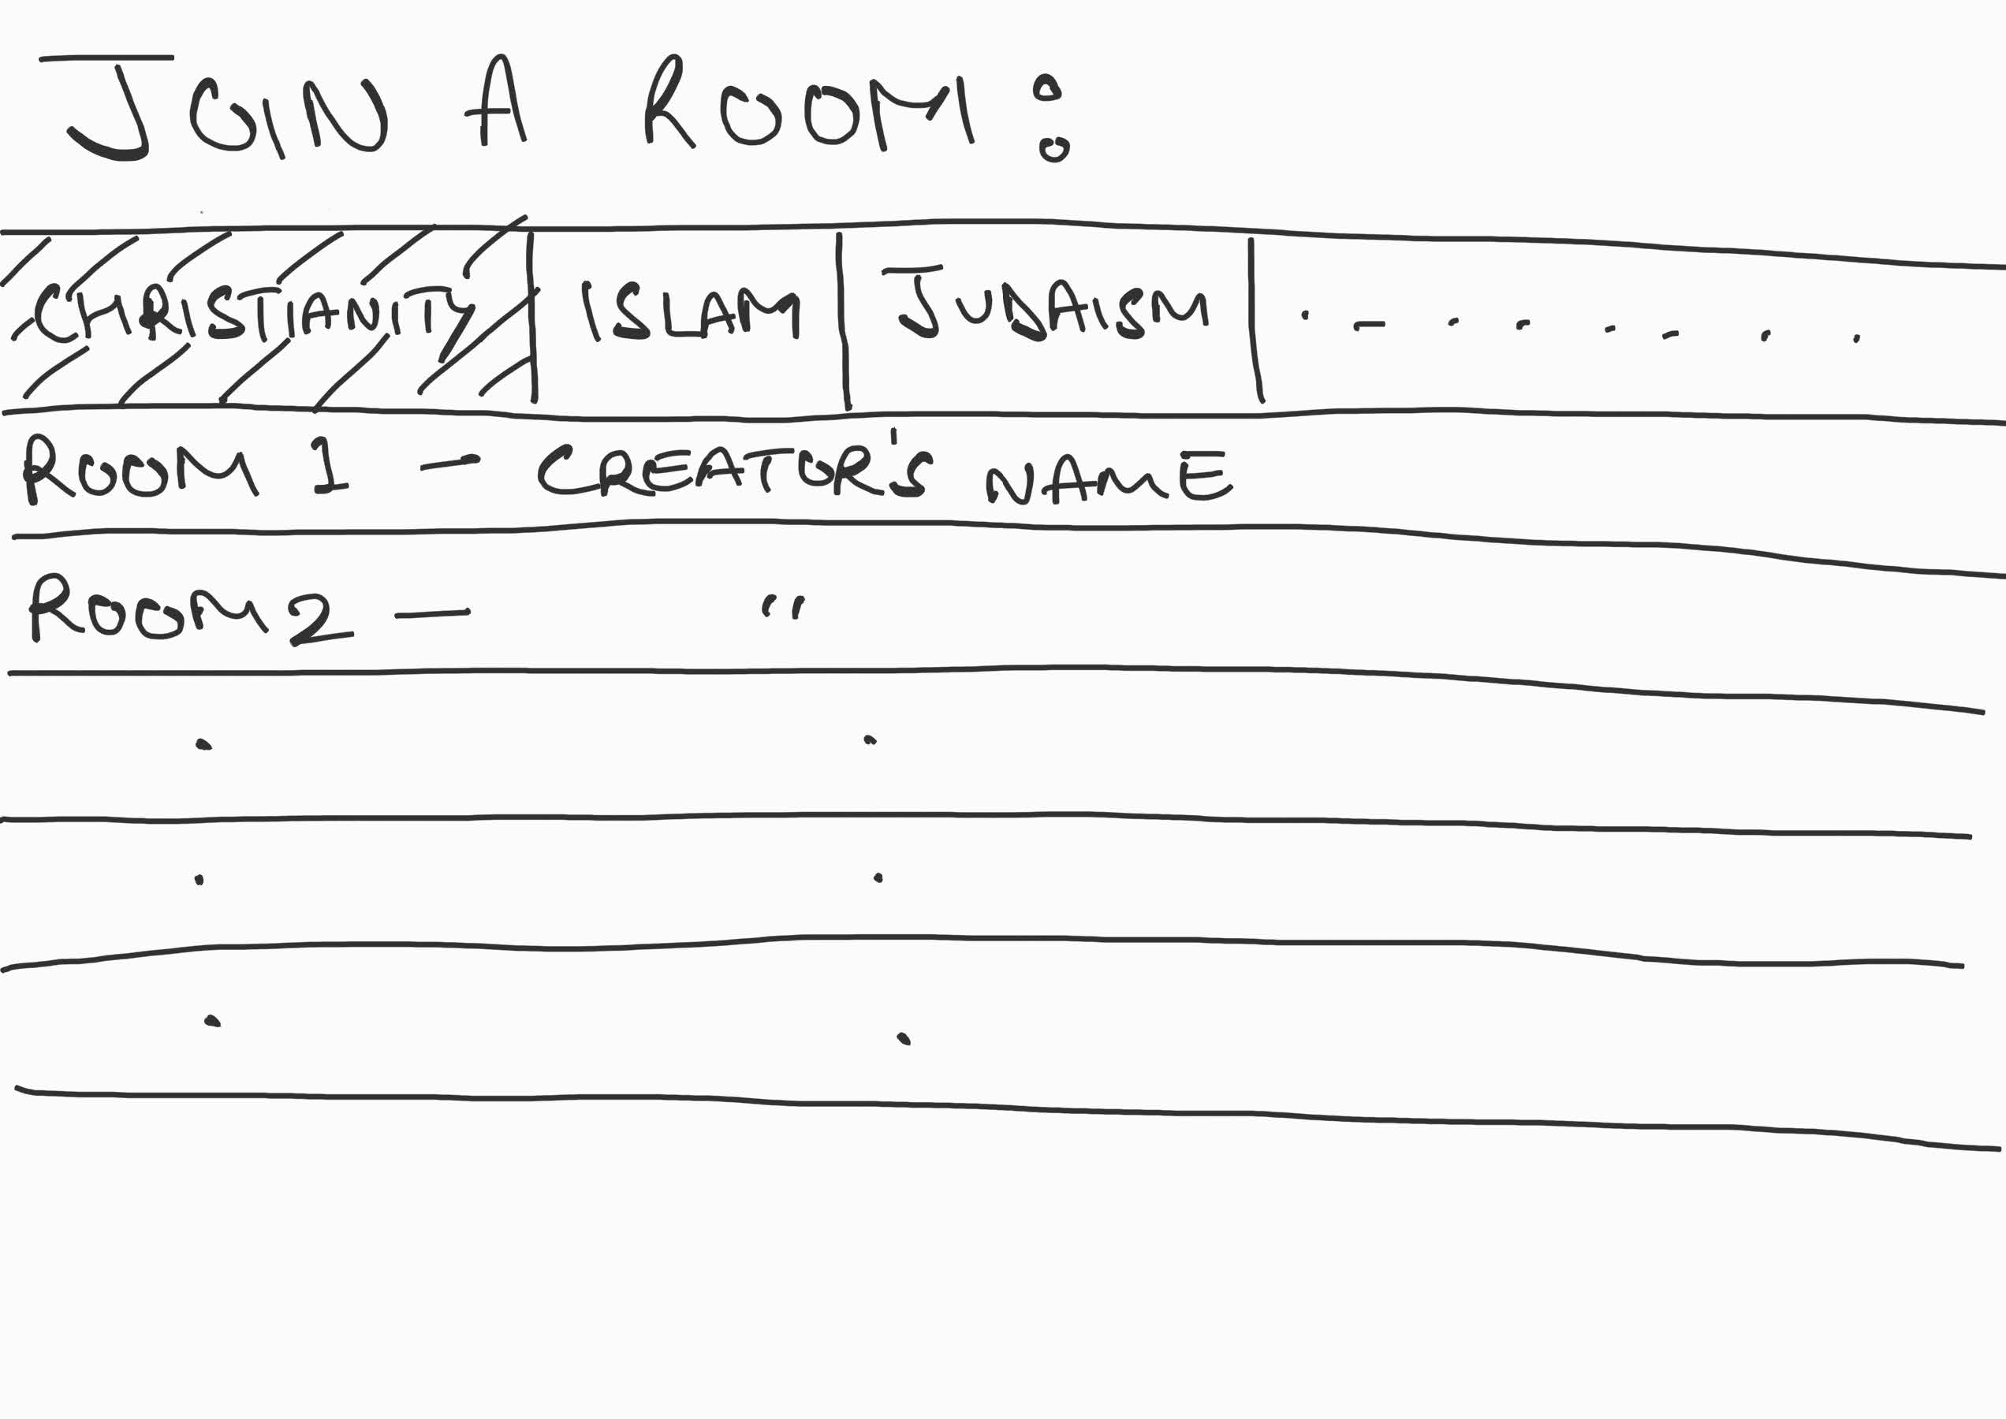
Sketches

Slide 15
Hagia Sophia – Brief Historic
Byzantine structure in Istanbul
Build 532–537 CE
537-1453 Cathedrale of the Ecumenical Patriarchate of Constantinople
1453-1935 Great Mosque after the Turkish conquest of Constantinople
1935-2020 Museum
2020-today Great Mosque
Since 1985 component of UNESCO World Heritage

Slide 16
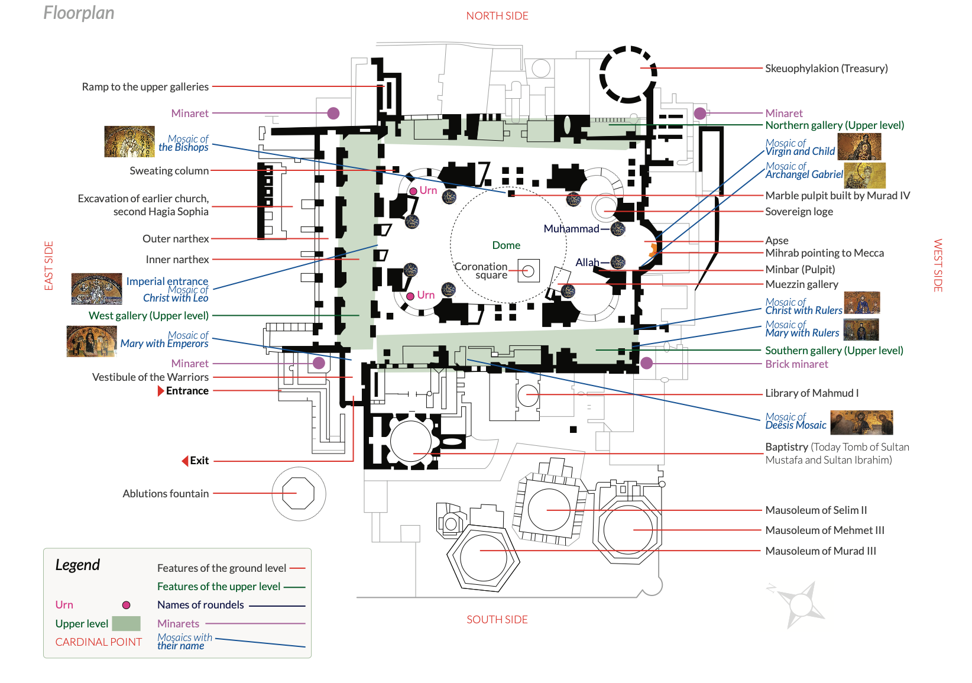
Hagia Sophia - Architecture

Slide 17
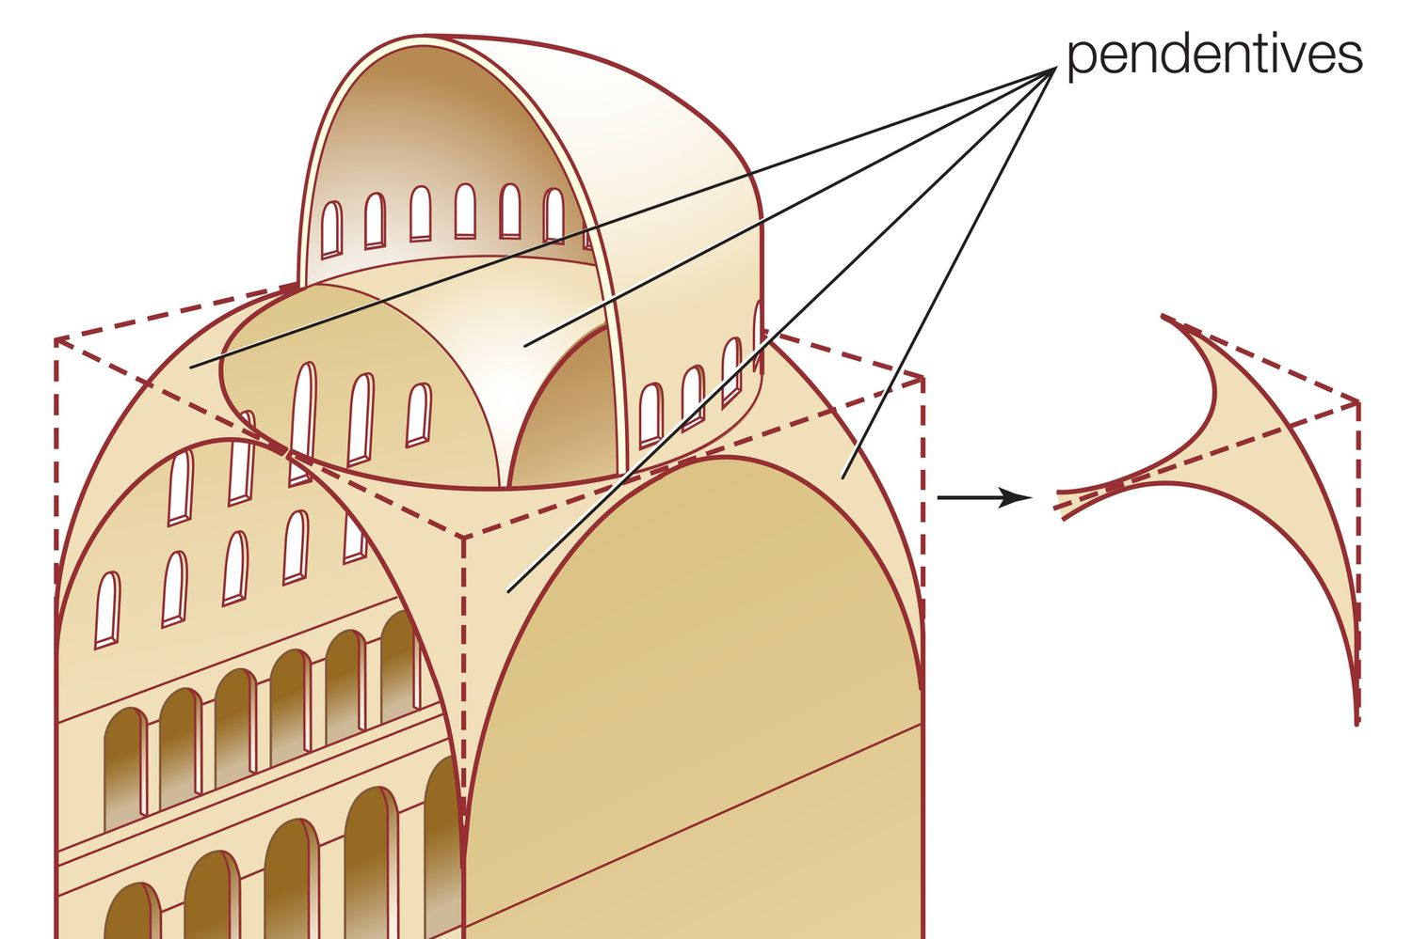
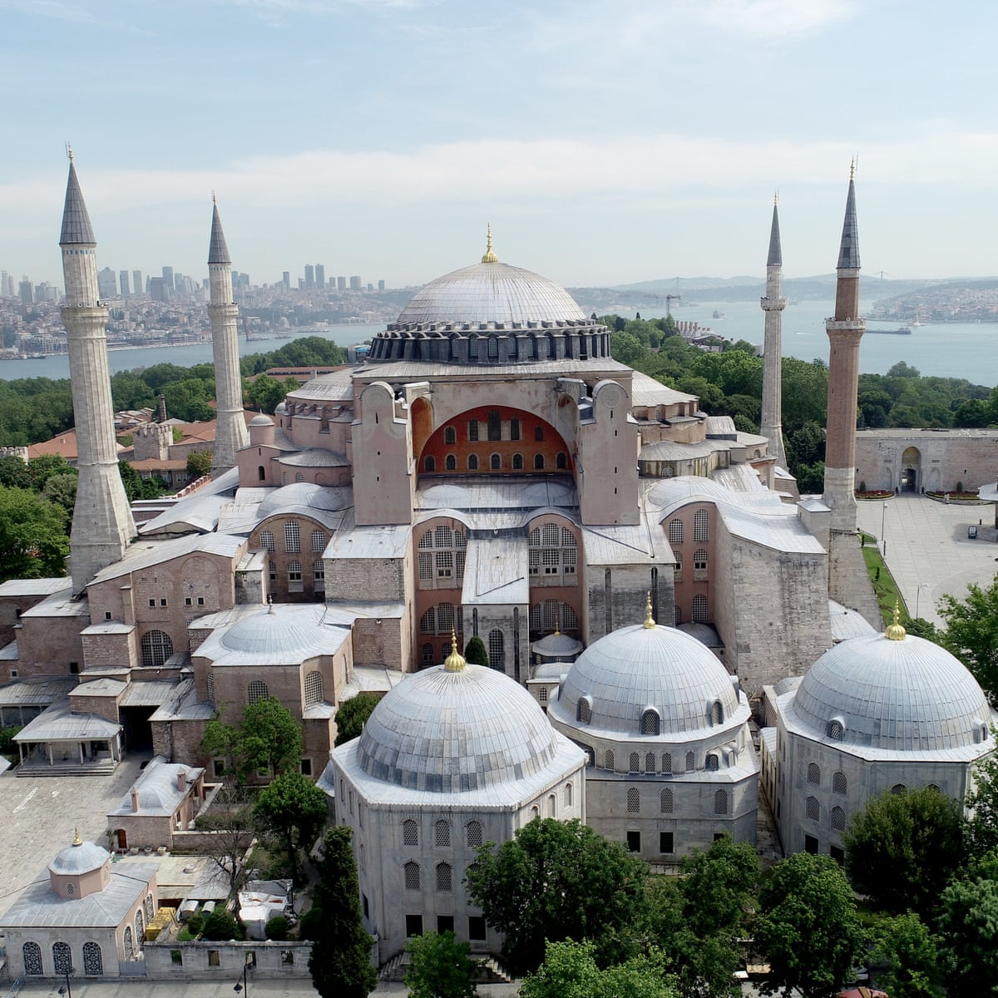
Hagia Sophia – Important Parts
Main part → Dome & 2 semidomes
Carried on 4 pendentives
Minarets
Mihrab
Minibar
Loge of Empress
Sultan‘s Lodge
Marble Door
Marble Jar
Mosaics
Tombs

Slide 18
Hagia Sophia
Current possible activity is exploring
With optional audio guide
Admission restriction due to clothing
Closed 5 times for prayer
Tourists should behave quietly and respectfully

Slide 19
Review – Struggles
Less progress than expected/planned
Beginning is meeting intensive
Finding times with everyone can be hard
Implementation hasn‘t started
We expect better understanding and visions when the practical part starts
Unaccustomed to level of selforganization

Slide 20
Next Steps
Talk about implementation details
Decide on spaces to use/model
Refine and plan first user stories in more detail
Start with implementation

